Slide 1


Market Basket Analysis Recommendation System
FINAL YEAR PROJECT PRESENTATION

Slide 2
Table of contents
01
02
03
Problem Statement and Solution
Objective Description
Proposed Methodology
04
05
Tools to be used
Conclusion

Slide 3

Problem Statement
Proposed Solution
Customers are unable to discover products they may like based on their current and previous purchases, leading to poor overall shopping experience discouraging them to explore more products.
The Market Basket Analysis (MBA) recommendation system involves implementation of an algorithm that identifies and suggests related products to customers based on their current purchases.

Slide 4
Objectives
Cross-Selling
Increase the average purchase value by recommending complementary products to customers.
Customer Engagement
Shopping Experience
Encourage customers to explore a wider range of products, leading to increased interaction and longer browsing sessions.
Provide tailored product suggestions to each customer, fostering a sense of individualized attention and satisfaction.
Sales Revenue Enhancement
Drive additional purchases by effectively promoting relevant products, ultimately contributing to the overall increase in sales and revenue.

Slide 5
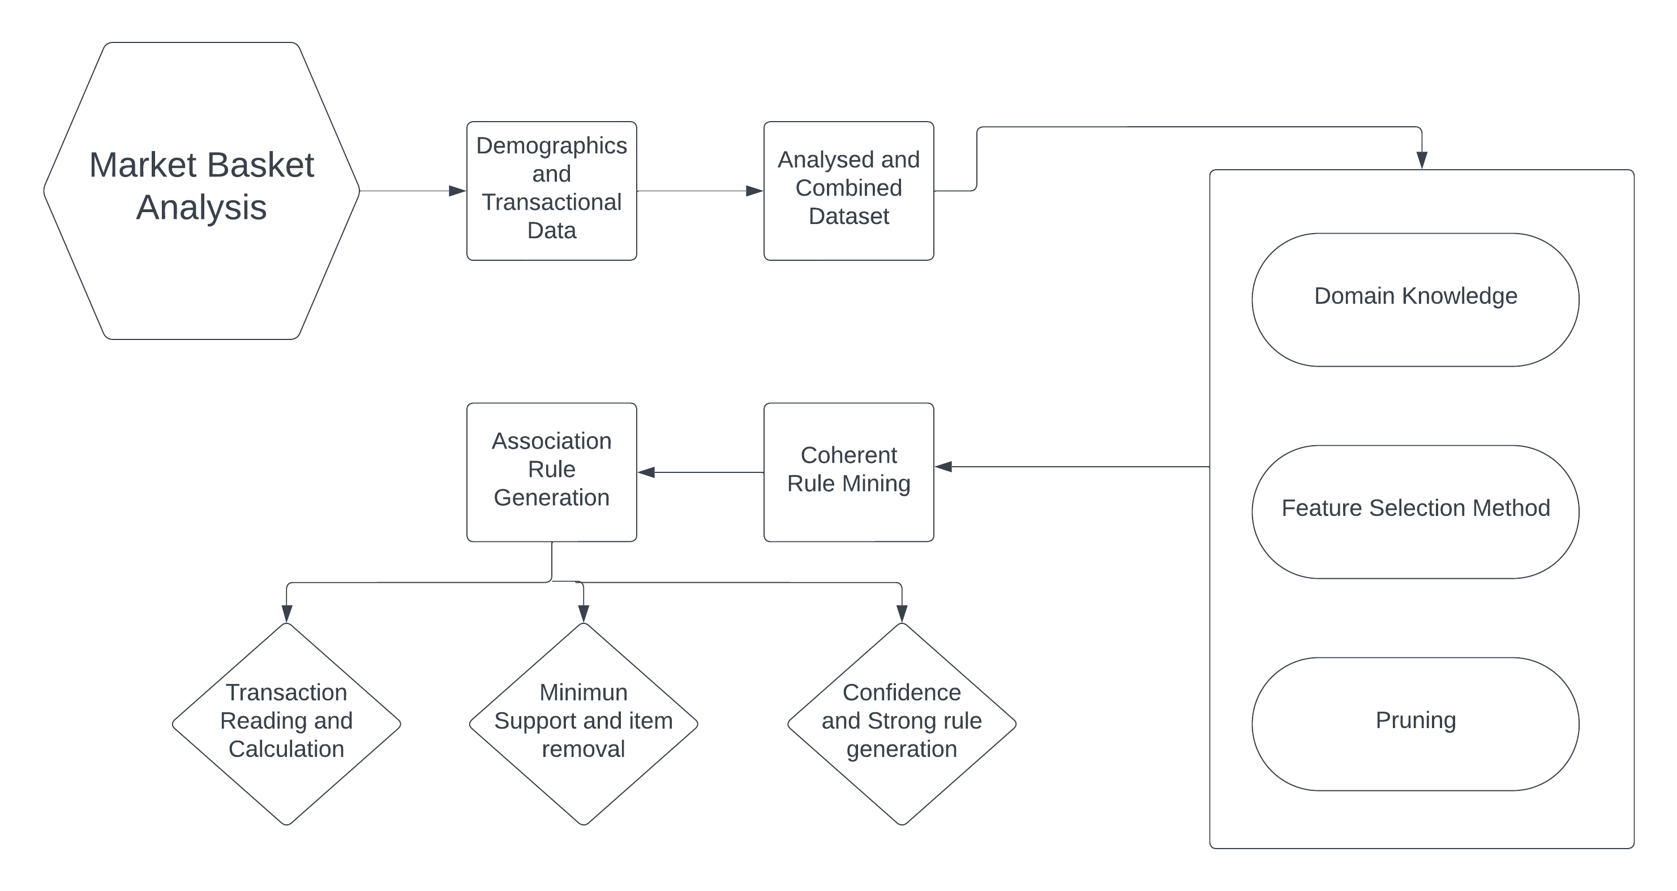
Flow Diagram

Slide 6
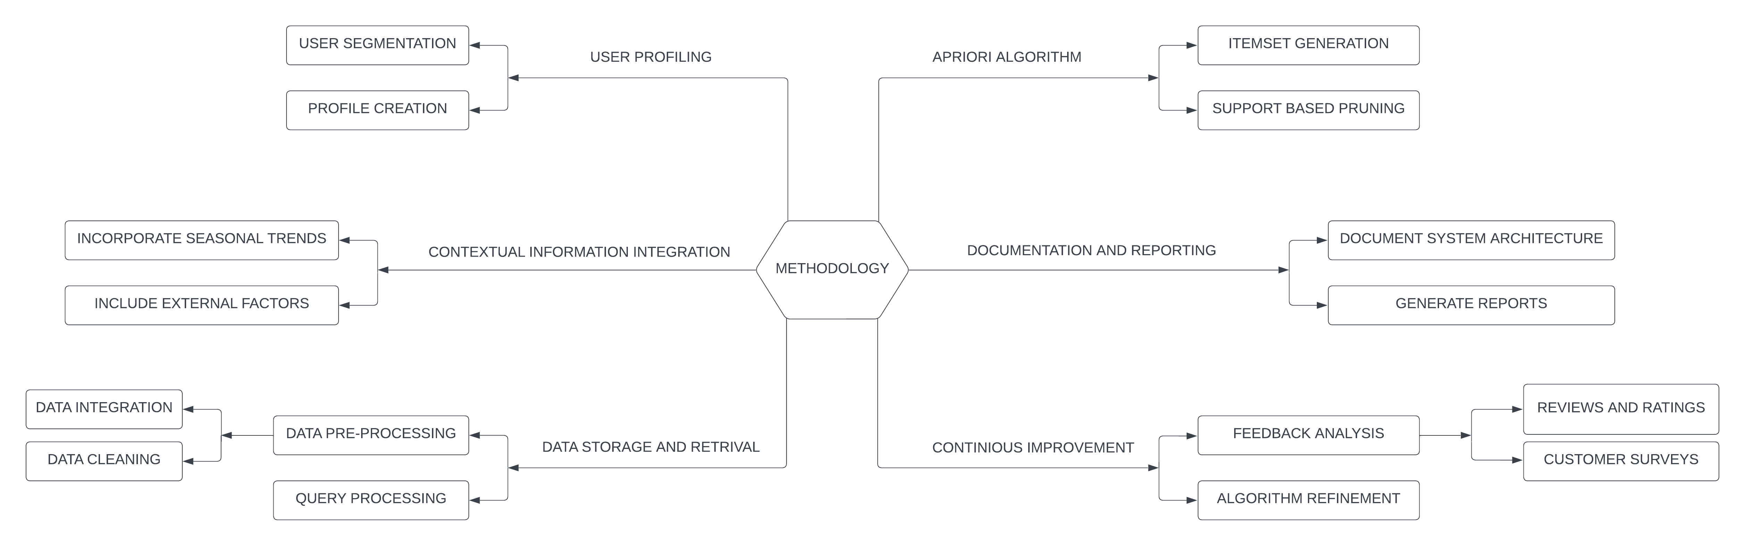
Methodology

Slide 7
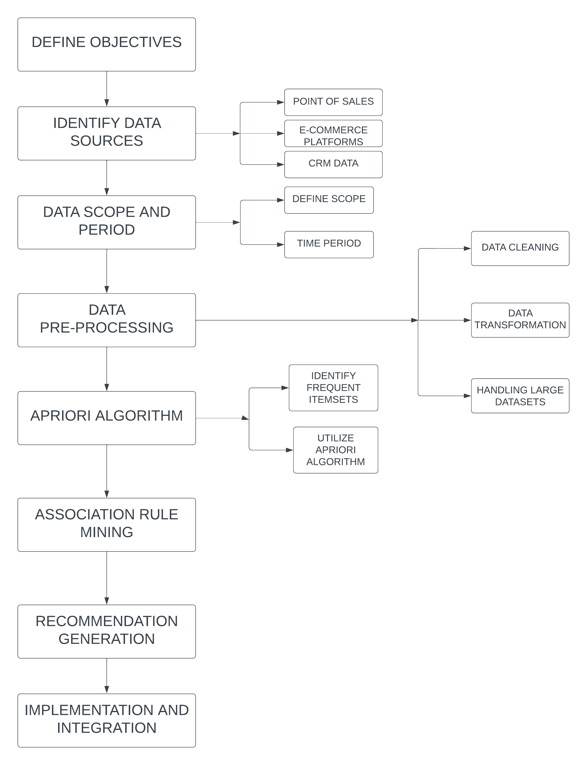
Technical Process

Slide 8
Tools to be used
Programming
Data Analysis
DBMS
Data Visualization
Python – Matplotlib,
Aggrid and Scikit-learn
Pandas and NumPy – Data Manipulation and Computation
Advanced Excel – Structured/Unstructured Data
Python and Streamlit – Dynamic visualization of data and trends

Slide 9
Project Execution

Slide 10
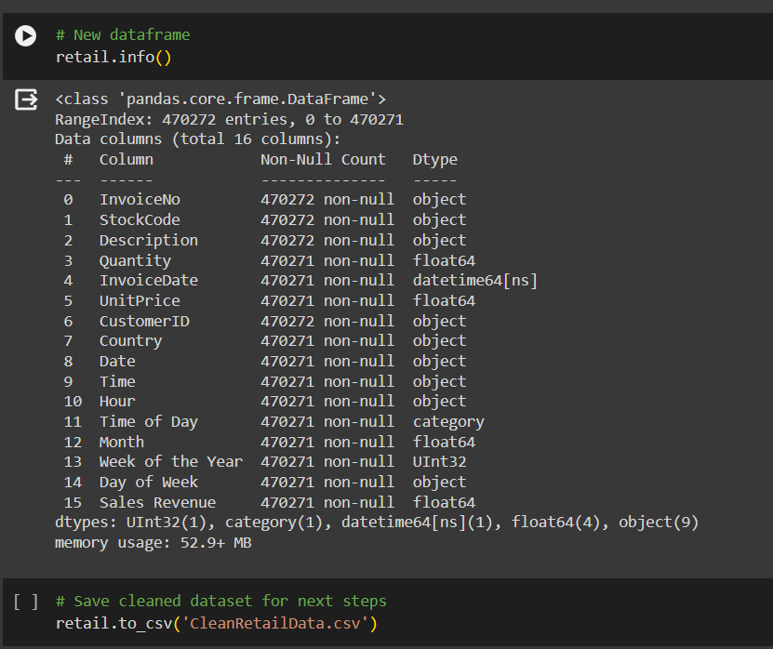
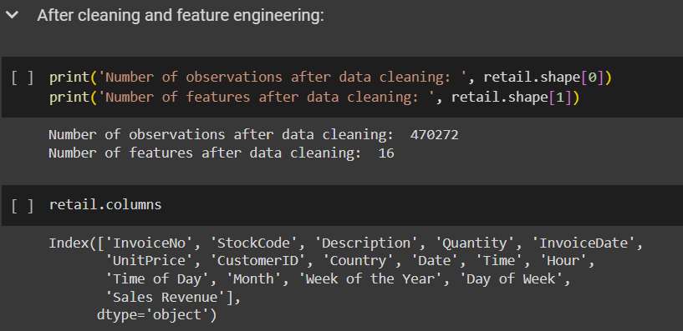
Feature Engineering
Identify relevant features based on domain knowledge and data understanding.
Explore transformations like scaling, binning, or one-hot encoding to enhance feature representation.
Create new features by combining existing ones through arithmetic operations, interactions, or domain-specific functions.
Evaluate feature importance through techniques like correlation analysis, feature selection algorithms, or model-based metrics to refine feature set.

Slide 11
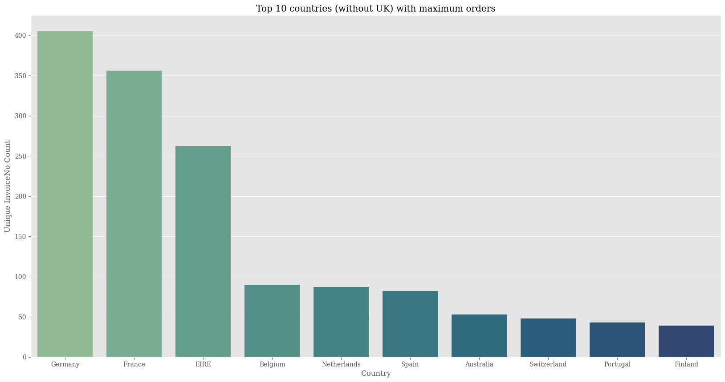
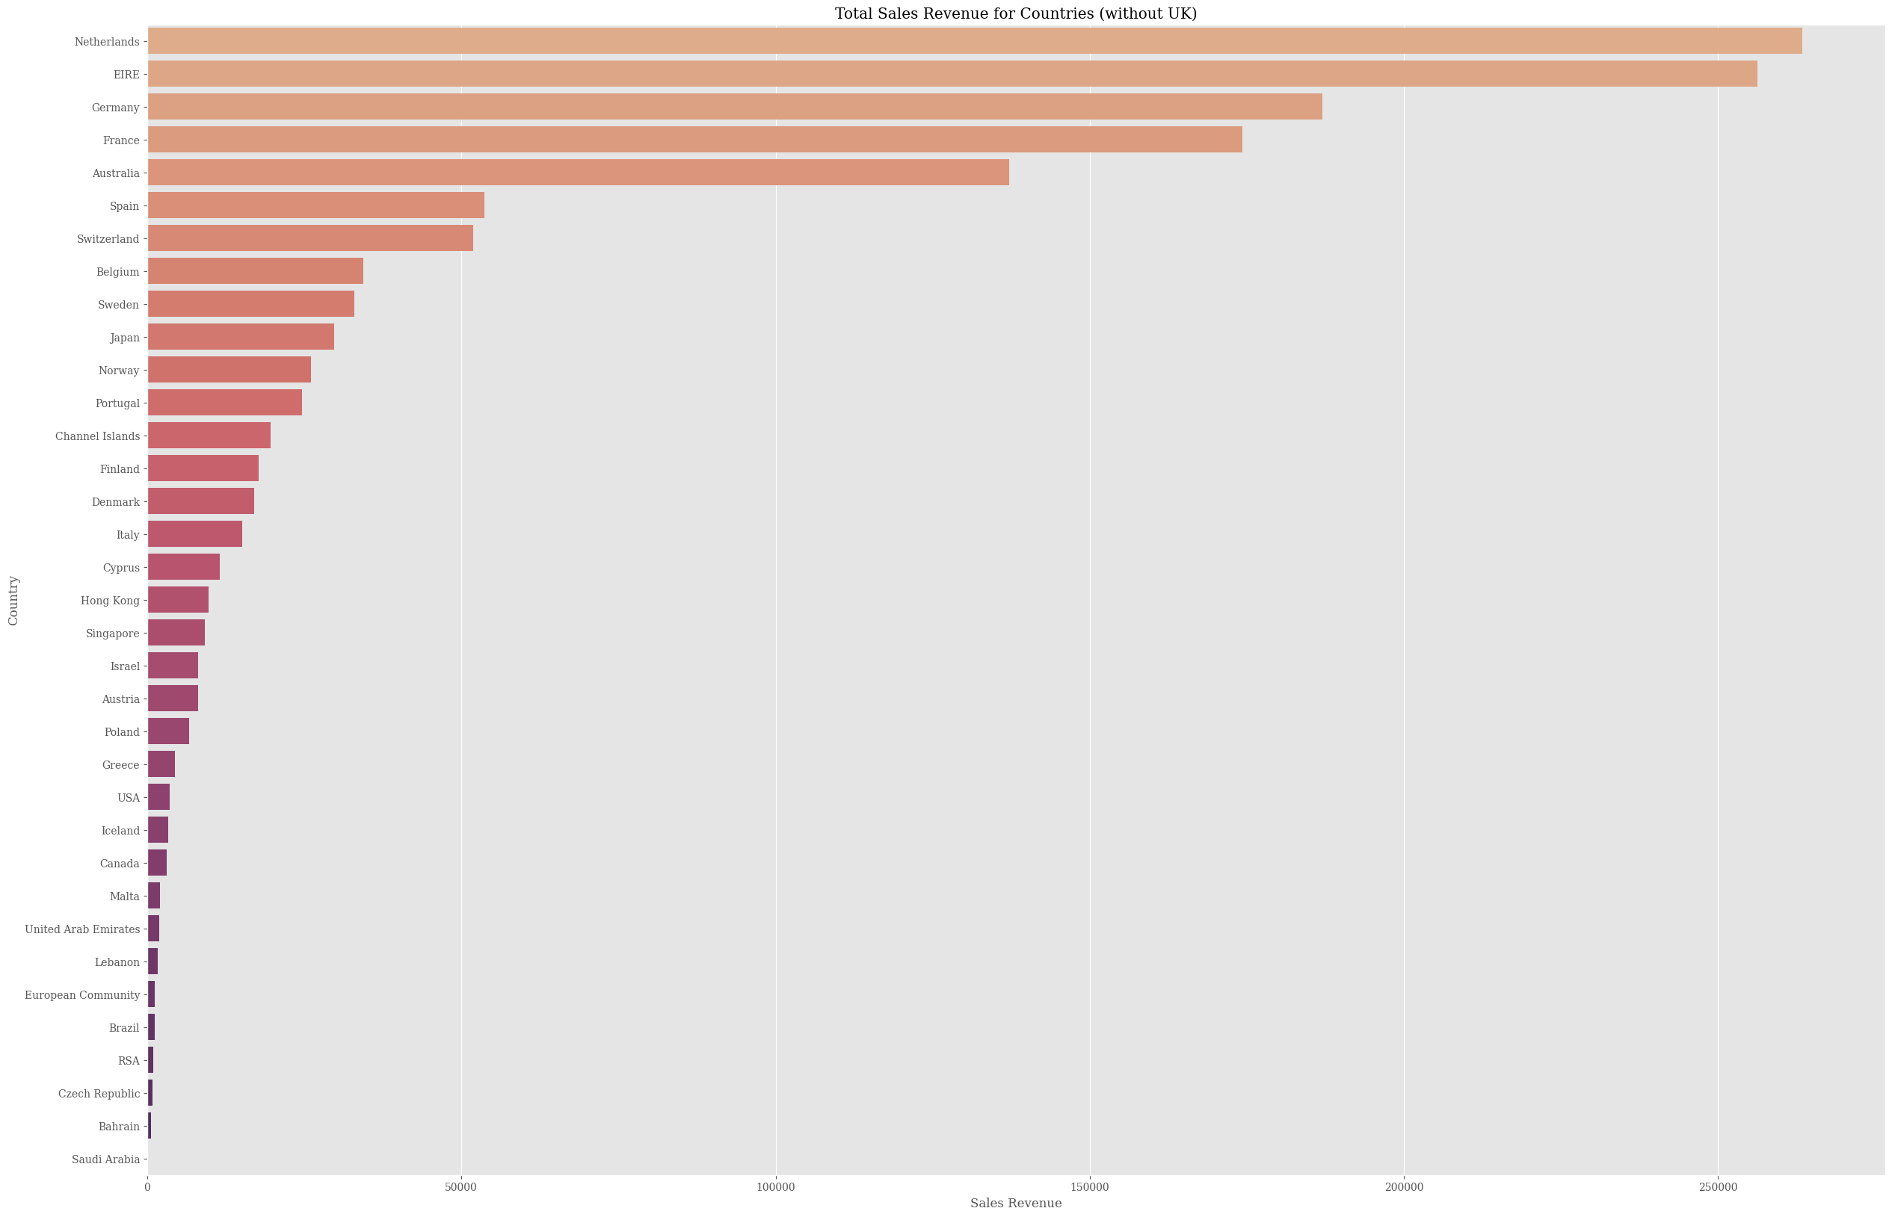
Exploratory Data Analysis
Exploratory Data Analysis (EDA) involves visualizing, summarizing, and interpreting data to understand its underlying patterns, distributions, and relationships.
Through techniques such as histograms, scatter plots, and summary statistics, EDA aids in uncovering insights and informing further analysis or modeling decisions.
It's a crucial initial step in the data analysis process, providing valuable context and guiding subsequent exploration and hypothesis testing.

Slide 12
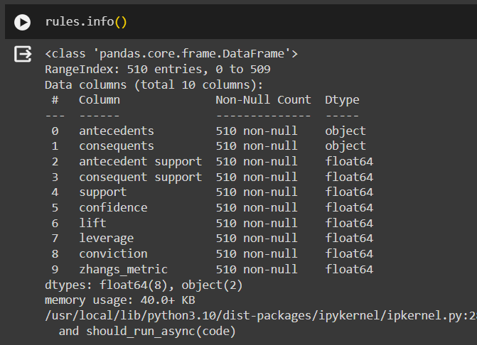
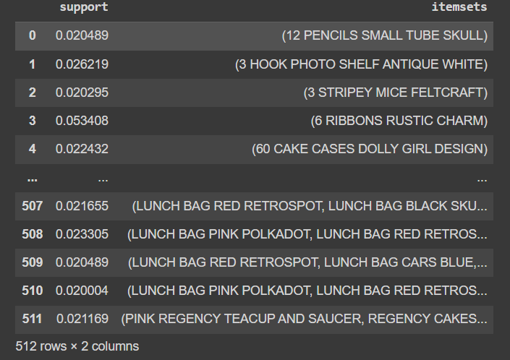
Rule Mining
Market basket analysis identifies patterns of co-occurrence between items bought together in transactions.
Apriori algorithm efficiently generates frequent itemsets by iteratively pruning infrequent itemsets.
Association rules highlight relationships between items, such as "If {milk, bread} then {butter}".
It aids in strategic pricing, product placement, and cross-selling strategies for businesses.

Slide 13
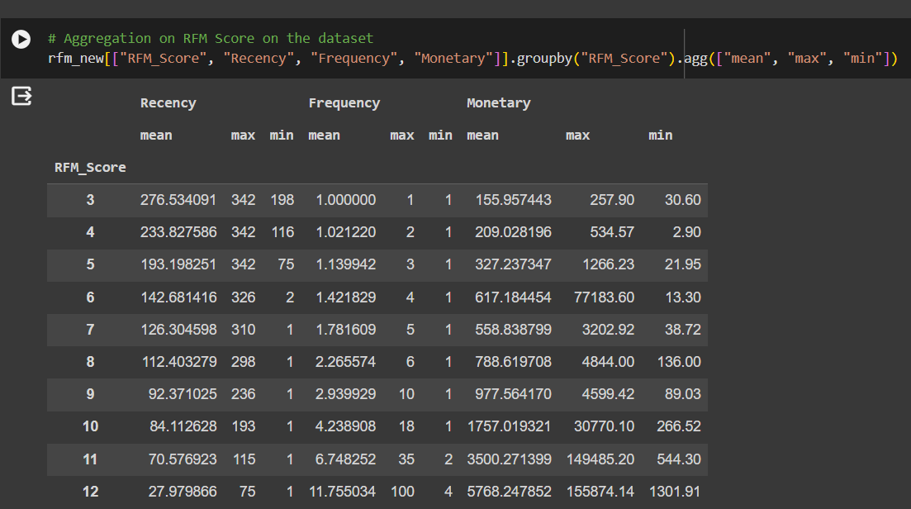
Customer Segmentation using RFM Analysis
Analyze customer Recency, Frequency, and Monetary value to segment them effectively.
Utilize RFM scores to categorize customers into distinct segments based on their recent purchases, buying frequency, and overall spending.
Create targeted marketing strategies tailored to each segment's behavior and preferences.
Improve customer retention and loyalty by delivering personalized experiences and promotions to different RFM segments.

Slide 14
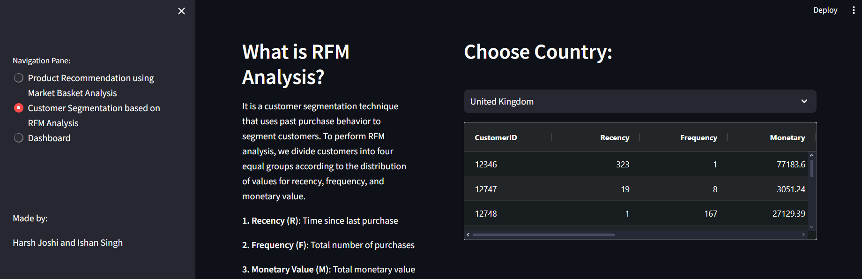
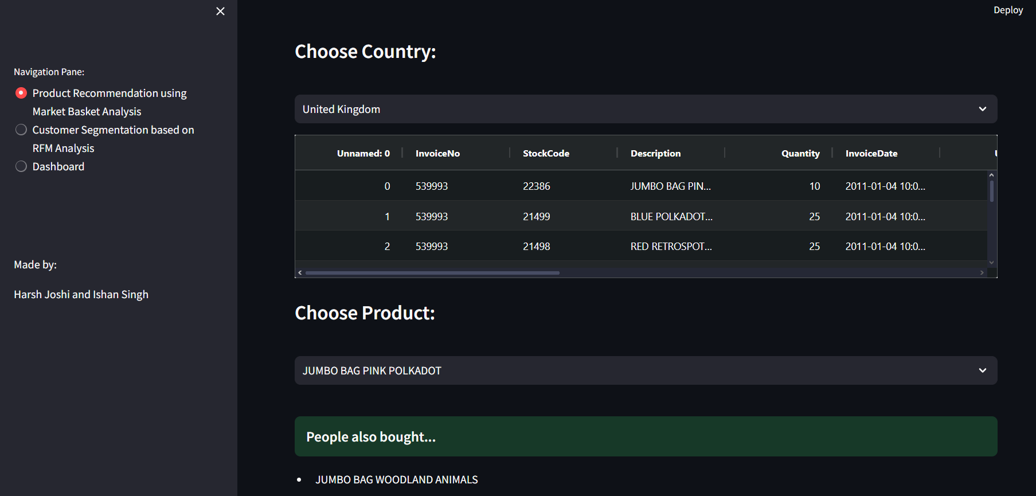
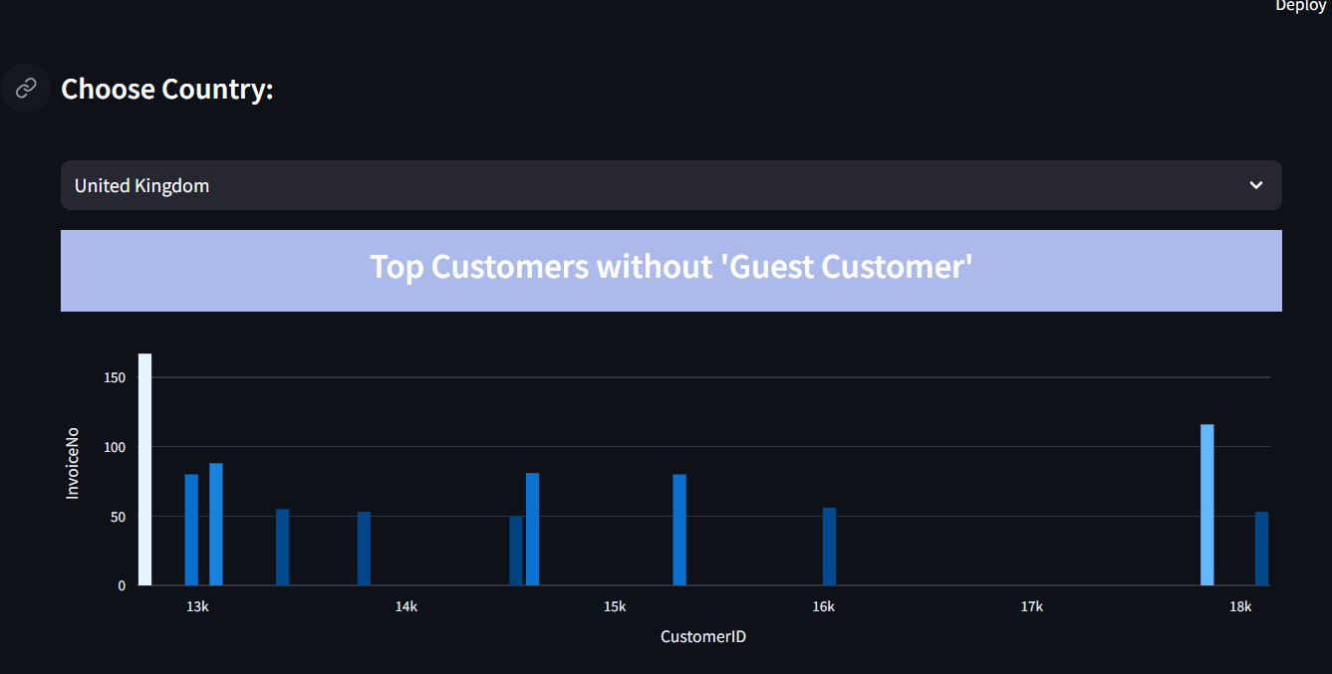
APP SNAPSHOTS

Slide 15

Conclusion
Crafting a powerful MBA recommendation system involves using Python or R for algorithms, pandas for data management, and databases like MySQL or MongoDB. Employing tools like Django, Flask, and visualization libraries ensures an intuitive interface and meaningful data representation, enhancing customer satisfaction and business growth

Slide 16

Group Details
Mentor:
Dr. Anuj Kumar
Made By:
Harsh Joshi 20200802189
Ishan Singh 20200802183

Slide 17

Thanks

